Slide 1

2021 NSC Grade 12 Class Report Card

Slide 2
PRESENTATION OUTLINE
Tracking the 2021 Grade 12 cohort…
National Performance
ECDoE performance:
Overall, Bachelors and Gateway Subjects
4. Provincial analysis
5. Cluster analysis
6. District analysis
7. Key subjects analysis per district

Slide 3
Grade 12 Tracking for 2010 - 2021
Year | Grade1 | Grade2 | Grade3 | Grade4 | Grade5 | Grade6 | Grade7 | Grade8 | Grade9 | Grade10 | Grade11 | Grade12 | Total
2010 | 210,507 | 177,672 | 172,095 | 177,216 | 171,164 | 166,206 | 163,242 | 155,492 | 141,495 | 151,432 | 121,158 | 71,406 | 1,879,085
2011 | 206,093 | 170,426 | 159,634 | 162,865 | 156,724 | 153,869 | 152,369 | 148,610 | 144,308 | 149,134 | 122,883 | 71,796 | 1,798,711
2012 | 207,968 | 177,025 | 159,982 | 157,546 | 151,574 | 147,961 | 146,816 | 144,262 | 147,165 | 150,555 | 125,721 | 71,727 | 1,788,302
2013 | 204,529 | 180,753 | 163,543 | 156,255 | 144,447 | 141,156 | 141,694 | 138,997 | 146,090 | 156,353 | 122,342 | 77,601 | 1,773,760
2014 | 203,719 | 184,580 | 171,924 | 162,528 | 147,043 | 138,427 | 139,453 | 136,930 | 143,260 | 162,010 | 128,223 | 73,210 | 1,791,307
2015 | 198,238 | 181,666 | 173,793 | 168,575 | 150,845 | 138,776 | 135,549 | 134,318 | 129,006 | 152,230 | 125,303 | 92,638 | 1,780,937
2016 | 169,109 | 162,774 | 158,794 | 159,463 | 145,929 | 134,013 | 126,833 | 125,030 | 116,174 | 136,953 | 114,122 | 91,246 | 1,640,440
2017 | 170,309 | 160,597 | 160,925 | 164,670 | 153,278 | 143,711 | 134,919 | 130,363 | 117,377 | 133,939 | 114,129 | 82,273 | 1,666,490
2018 | 167,837 | 157,410 | 156,041 | 162,985 | 153,930 | 147,844 | 141,419 | 134,482 | 118,905 | 131,394 | 107,606 | 82,695 | 1,662,548
2019 | 164,526 | 162,838 | 157,497 | 165,653 | 157,103 | 152,604 | 150,073 | 145,447 | 125,339 | 134,541 | 106,073 | 80,183 | 1,701,877
2020 | 160,589 | 154,665 | 156,780 | 162,279 | 154,739 | 151,773 | 152,043 | 154,678 | 134,677 | 144,268 | 111,924 | 80,427 | 1,718,842
2021 | 155,636 | 151,616 | 151,679 | 158,296 | 154,843 | 151,098 | 150,618 | 151,951 | 141,249 | 137,639 | 120,386 | 95,424 | 1,720,435

Slide 4
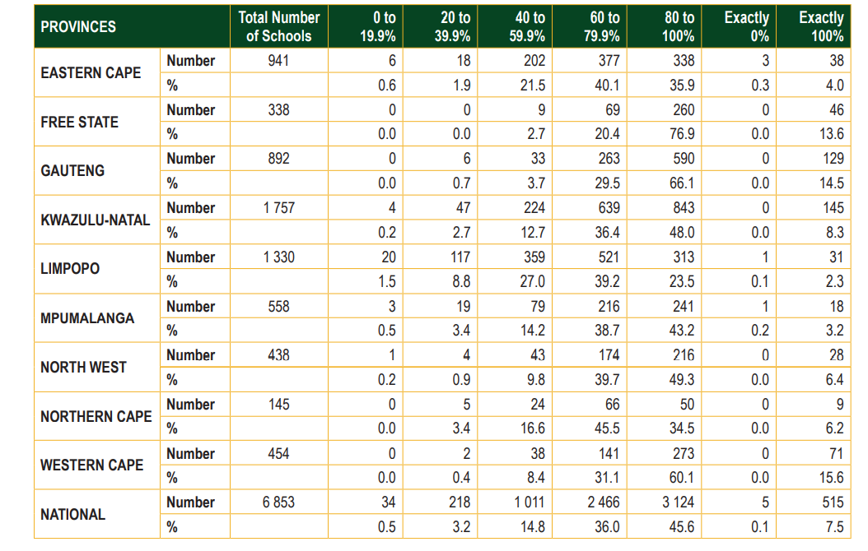
NATIONAL SUMMARY OF SCHOOL PERFORMANCE

Slide 5
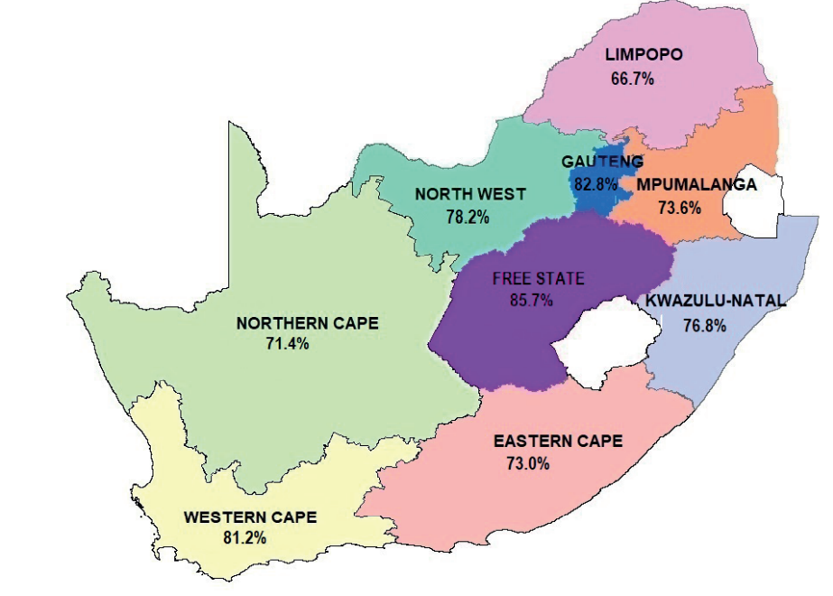
NATIONAL PERFORMANCE

Slide 6
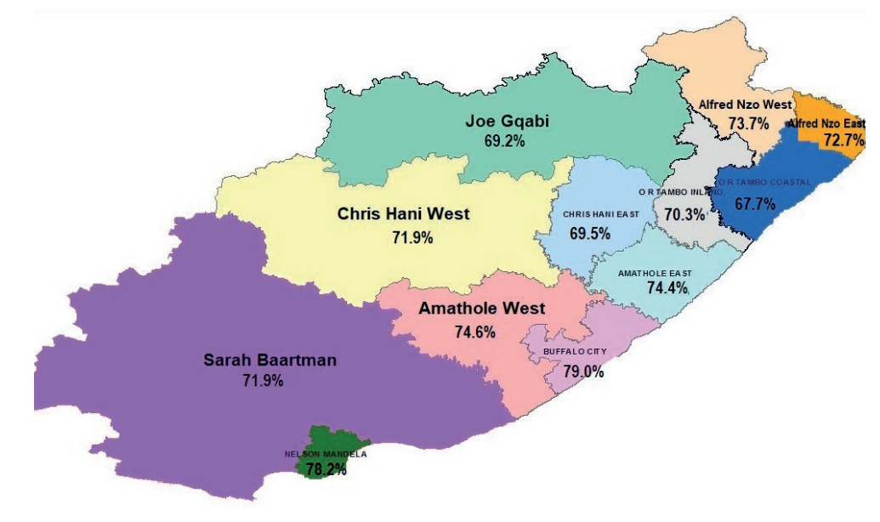
PROVINCIAL PERFORMANCE

Slide 7
PROVINCIAL PASS RATE

Slide 8
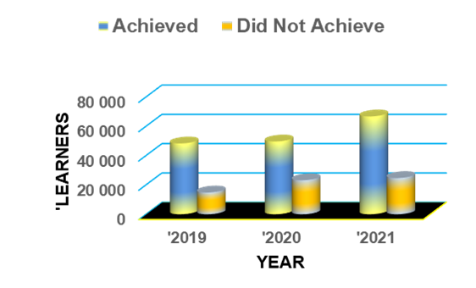
PROVINCIAL PASS RATE

Slide 9
PROVINCIAL PASS RATE

Slide 10
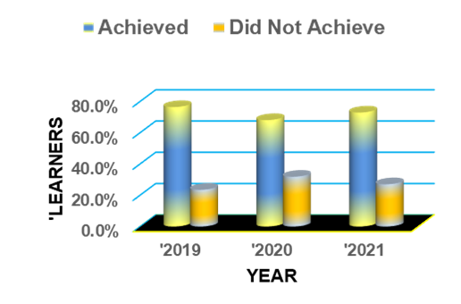
PROVINCIAL PASS RATE

Slide 11
CLUSTER A

Slide 12
CLUSTER A DISTRICTS
DISTRICT | YEAR | Achieved | Did Not Achieve | Total
ALFRED NZO EAST | '2019 | 2 835 | 818 | 3 653
 | '2020 | 3 030 | 1 408 | 4 438
 | '2021 | 4 441 | 1 666 | 6 107
ALFRED NZO WEST | '2019 | 5 163 | 1 553 | 6 716
 | '2020 | 5 419 | 2 613 | 8 032
 | '2021 | 6 607 | 2 353 | 8 960
CHRIS HANI EAST | '2019 | 2 601 | 1 017 | 3 618
 | '2020 | 2 562 | 1 556 | 4 118
 | '2021 | 3 457 | 1 514 | 4 971
JOE GQABI | '2019 | 2 326 | 719 | 3 045
 | '2020 | 2 325 | 1 456 | 3 781
 | '2021 | 3 527 | 1 567 | 5 094
OR TAMBO COASTAL | '2019 | 5 356 | 1 543 | 6 899
 | '2020 | 5 947 | 3 180 | 9 127
 | '2021 | 8 598 | 4 106 | 12 704
OR TAMBO INLAND | '2019 | 6 248 | 2 012 | 8 260
 | '2020 | 5 823 | 3 110 | 8 933
 | '2021 | 7 917 | 3 348 | 11 265

Slide 13
CLUSTER A DISTRICTS %
DISTRICT | YEAR | Achieved | Did Not Achieve
ALFRED NZO EAST | '2019 | 77.6% | 22.4%
 | '2020 | 68.3% | 31.7%
 | '2021 | 72.7% | 27.3%
ALFRED NZO WEST | '2019 | 76.9% | 23.1%
 | '2020 | 67.5% | 32.5%
 | '2021 | 73.7% | 26.3%
CHRIS HANI EAST | '2019 | 71.9% | 28.1%
 | '2020 | 62.2% | 37.8%
 | '2021 | 69.5% | 30.5%
JOE GQABI | '2019 | 76.4% | 23.6%
 | '2020 | 61.5% | 38.5%
 | '2021 | 69.2% | 30.8%
OR TAMBO COASTAL | '2019 | 77.6% | 22.4%
 | '2020 | 65.2% | 34.8%
 | '2021 | 67.7% | 32.3%
OR TAMBO INLAND | '2019 | 75.6% | 24.4%
 | '2020 | 65.2% | 34.8%
 | '2021 | 70.3% | 29.7%

Slide 14
CLUSTER B: PASS OVER 3YRS

Slide 15
CLUSTER B: PASS % OVER 3YRS

Slide 16
CLUSTER B: DISTRICTS
DISTRICT | YEAR | Achieved | Did Not Achieve | Total
AMATHOLE WEST | '2019 | 1 986 | 1 082 | 3 068
 | '2020 | 1 936 | 1 129 | 3 065
 | '2021 | 2 744 | 933 | 3 677
BUFFALO CITY | '2019 | 5 694 | 1 612 | 7 306
 | '2020 | 6 113 | 2 188 | 8 301
 | '2021 | 8 112 | 2 162 | 10 274
CHRIS HANI WEST | '2019 | 2 996 | 978 | 3 974
 | '2020 | 3 147 | 1 318 | 4 465
 | '2021 | 4 206 | 1 646 | 5 852
NELSON MANDELA | '2019 | 6 512 | 1 490 | 8 002
 | '2020 | 7 081 | 2 292 | 9 373
 | '2021 | 8 985 | 2 504 | 11 489
SARAH BAARTMAN | '2019 | 1 850 | 634 | 2 484
 | '2020 | 1 944 | 866 | 2 810
 | '2021 | 2 506 | 979 | 3 485
AMATHOLE EAST | '2019 | 4 764 | 1 409 | 6 173
 | '2020 | 4 364 | 2 119 | 6 483
 | '2021 | 5 670 | 1 952 | 7 622

Slide 17
CLUSTER B: DISTRICTS
DISTRICT | YEAR | Achieved | Did Not Achieve
AMATHOLE WEST | '2019 | 64.7% | 35.3%
 | '2020 | 63.2% | 36.8%
 | '2021 | 74.6% | 25.4%
BUFFALO CITY | '2019 | 77.9% | 22.1%
 | '2020 | 73.6% | 26.4%
 | '2021 | 79.0% | 21.0%
CHRIS HANI WEST | '2019 | 75.4% | 24.6%
 | '2020 | 70.5% | 29.5%
 | '2021 | 71.9% | 28.1%
NELSON MANDELA | '2019 | 81.4% | 18.6%
 | '2020 | 75.5% | 24.5%
 | '2021 | 78.2% | 21.8%
SARAH BAARTMAN | '2019 | 74.5% | 25.5%
 | '2020 | 69.2% | 30.8%
 | '2021 | 71.9% | 28.1%
AMATHOLE EAST | '2019 | 77.2% | 22.8%
 | '2020 | 67.3% | 32.7%
 | '2021 | 74.4% | 25.6%

Slide 18
DISTRICTS POSITIONS
 | '2020 |  | '2021
DISTRICT | Achieved | POSITION | Achieved | Diff 2021 - 2020 | POSITION
BUFFALO CITY | 73.6% | 2 | 79.0% | 5.3% | 1
NELSON MANDELA | 75.5% | 1 | 78.2% | 2.7% | 2
AMATHOLE WEST | 63.2% | 10 | 74.6% | 11.5% | 3
AMATHOLE EAST | 67.3% | 7 | 74.4% | 7.1% | 4
ALFRED NZO WEST | 67.5% | 6 | 73.7% | 6.3% | 5
ALFRED NZO EAST | 68.3% | 5 | 72.7% | 4.4% | 6
SARAH BAARTMAN | 69.2% | 4 | 71.9% | 2.7% | 7
CHRIS HANI WEST | 70.5% | 3 | 71.9% | 1.4% | 8
OR TAMBO INLAND | 65.2% | 8 | 70.3% | 5.1% | 9
CHRIS HANI EAST | 62.2% | 11 | 69.5% | 7.3% | 10
JOE GQABI | 61.5% | 12 | 69.2% | 7.7% | 11
OR TAMBO COASTAL | 65.2% | 9 | 67.7% | 2.5% | 12

Slide 19
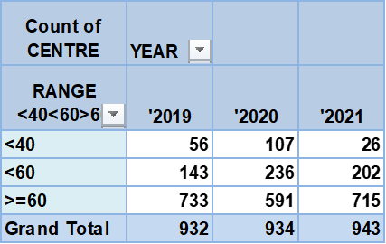
SCHOOL PERFORMANCE

Slide 20
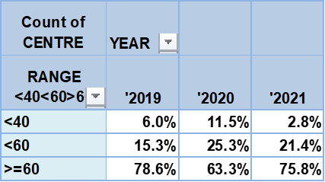
SCHOOL PERFORMANCE

Slide 21
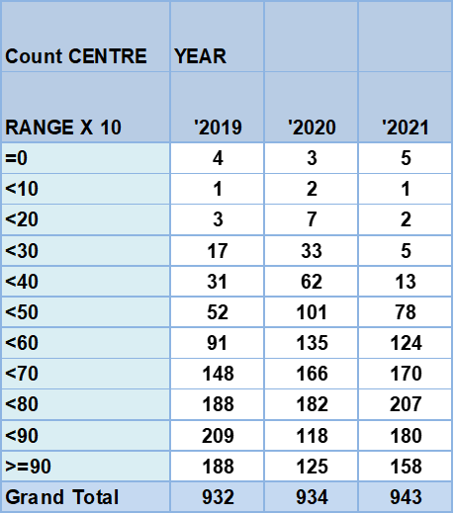
SCHOOL CLASSIFICATION

Slide 22
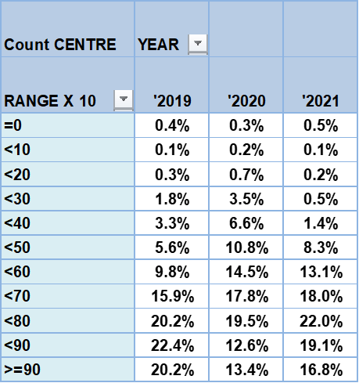
SCHOOL CLASSIFICATION

Slide 23

LEARNERS CLASSIFICATION

Slide 24
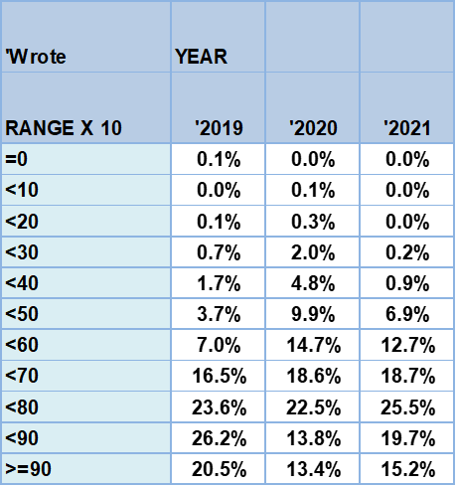
LEARNERS CLASSIFICATION

Slide 25
SUBJECT PERFORMANCE
SUBJECT | 2019 | 2020 | 2021 | DIFF
Accounting | 80.7% | 72.3% | 76.4% | 4.0%
Afrikaans 1st Additional | 97.0% | 95.1% | 96.0% | 0.9%
Afrikaans 2nd Additional | 95.9% | 85.3% | 94.8% | 9.5%
Afrikaans Home | 82.1% | 83.7% | 82.4% | -1.3%
Agricultural Management Practices | 91.0% | 90.6% | 89.1% | -1.5%
Agricultural Sciences | 80.9% | 76.5% | 81.2% | 4.6%
Agricultural Technology | 100.0% | 95.8% | 100.0% | 4.2%
Arabic 2nd Additional | 100.0% | 100.0% | 100.0% | 0.0%
Business Studies | 68.1% | 77.8% | 80.6% | 2.7%
Civil Technology (Civil Services) | 93.3% | 87.9% | 100.0% | 12.1%
Civil Technology (Construction) | 99.2% | 95.0% | 96.2% | 1.2%
Civil Technology (Woodworking) | 99.4% | 90.2% | 92.9% | 2.7%
Computer Applications Technology | 91.5% | 91.2% | 87.7% | -3.4%
Consumer Studies | 95.4% | 94.9% | 96.5% | 1.6%
Dance Studies | 100.0% | 100.0% | 100.0% | 0.0%
Design | 96.4% | 98.7% | 99.0% | 0.3%

Slide 26
SUBJECT PERFORMANCE
SUBJECT | 2019 | 2020 | 2021 | DIFF
Design | 96.4% | 98.7% | 99.0% | 0.3%
Dramatic Arts | 100.0% | 96.8% | 99.6% | 2.8%
Economics | 73.1% | 70.2% | 73.4% | 3.3%
Electrical Technology (Digital Systems) | 100.0% | 100.0% | 100.0% | 0.0%
Electrical Technology (Electronics) | 98.9% | 96.6% | 89.9% | -6.7%
Electrical Technology (Power Systems) | 95.7% | 92.3% | 94.5% | 2.2%
Engineering Graphics & Design | 94.6% | 91.1% | 90.8% | -0.3%
English 1st Additional | 96.5% | 98.5% | 98.8% | 0.3%
English Home | 90.2% | 93.1% | 92.7% | -0.4%
French 2nd Additional | 100.0% | 100.0% | 100.0% | 0.0%
Geography | 80.8% | 69.0% | 73.8% | 4.8%
History | 87.2% | 88.0% | 89.3% | 1.3%
Hospitality Studies | 97.9% | 91.6% | 95.5% | 3.9%
Information Technology | 89.1% | 85.6% | 93.3% | 7.7%
Isixhosa 1st Additional | 99.9% | 99.9% | 99.9% | 0.1%
Isixhosa Home | 99.8% | 99.7% | 99.7% | 0.0%

Slide 27
SUBJECT PERFORMANCE
SUBJECT | 2019 | 2020 | 2021 | DIFF
Isizulu Home | 83.3% | 100.0% | 83.3% | -16.7%
Life Orientation | 99.8% | 99.3% | 99.8% | 0.5%
Life Sciences | 71.2% | 68.8% | 70.8% | 2.0%
Maritime Economics | 100.0% | 96.8% | 100.0% | 3.2%
Mathematical Literacy | 76.0% | 73.7% | 72.3% | -1.4%
Mathematics | 41.8% | 39.7% | 46.6% | 6.9%
Mechanical Technology (Automotive) | 92.5% | 88.6% | 88.3% | -0.3%
Mechanical Technology (Fitting & Machine) | 97.1% | 97.2% | 95.9% | -1.3%
Mechanical Technology (Welding and Metal) | 77.2% | 89.6% | 92.7% | 3.1%
Music | 99.8% | 99.6% | 99.5% | -0.1%
Nautical Science | 23.1% | 82.4% | 90.3% | 8.0%
Physical Sciences | 70.3% | 55.6% | 62.3% | 6.6%
Religion Studies | 94.1% | 83.3% | 71.4% | -11.9%
Sesotho Home | 99.8% | 99.8% | 99.6% | -0.1%
South African Sign Home | 100.0% | 91.7% | 87.1% | -4.6%
Technical Mathematics | 38.5% | 26.3% | 50.7% | 24.4%

Slide 28
SUBJECT PERFORMANCE
SUBJECT | 2019 | 2020 | 2021 | DIFF
Technical Sciences | 83.6% | 77.8% | 87.1% | 9.3%
Tourism | 97.1% | 97.1% | 97.3% | 0.2%
Visual Arts | 95.2% | 98.4% | 91.8% | -6.6%
30 | Improved | 60.0
15 | Dropped | 30.0
5 | Stable | 10.0
50 |  | 100

Slide 29
PROVINCIAL PASS CATEGORIES
RESULT | '2019 | '2020 | '2021
Achieved Bachelor | 32.3% | 30.0% | 34.3%
Achieved Diploma | 28.2% | 24.3% | 24.5%
Achieved Higher Cert | 15.9% | 13.8% | 14.2%
Achieved NSC | 0.1% | 0.0% | 0.0%
Achieved Endorsed | 0.0% | 0.0% | 0.0%
Did Not Achieve | 23.5% | 31.9% | 27.0%

Slide 30
BACHELOR PASSES
DISTRICTS | '2019 | '2020 | '2021
ALFRED NZO EAST | 30.6% | 27.3% | 32.8%
ALFRED NZO WEST | 28.8% | 27.5% | 33.9%
AMATHOLE EAST | 31.7% | 28.3% | 35.7%
AMATHOLE WEST | 21.7% | 25.9% | 35.9%
BUFFALO CITY | 37.4% | 37.5% | 42.9%
CHRIS HANI EAST | 29.4% | 27.3% | 31.1%
CHRIS HANI WEST | 30.1% | 29.7% | 30.9%
JOE GQABI | 30.5% | 25.8% | 27.3%
NELSON MANDELA | 39.2% | 36.9% | 39.2%
SARAH BAARTMAN | 32.0% | 32.8% | 33.6%
OR TAMBO COASTAL | 31.3% | 24.9% | 28.0%
OR TAMBO INLAND | 33.0% | 29.7% | 34.9%

Slide 31
DISTINCTIONS
Pass Criteria | '2019 | '2020 | '2021
Distinction | 15 745 | 17 099 | 24 174

Slide 32
PROGRESSED LEARNERS
Result Status | NO | % | %
A/BACH - Achieved - Bachelors | 235 | 3.28% | 27.2%
A/DIP - Achieved - Diploma | 757 | 10.57%
A/HC - Achieved - Higher Certificate | 951 | 13.28%
A/NSC - Achieved - NSC | 3 | 0.04%
DNA - did not achieve | 4 596 | 64.19%
I - Incomplete | 618 | 8.63%
Grand Total | 7 160 | 100%

Slide 33
PERFORMANCE OF SPECIAL SCHOOLS
YEAR | NO WROTE | PASSED | % PASS
2020 | 82 | 65 | 79.3
2021 | 93 | 71 | 76.3

Slide 34
2021 GENDER PERFORMANCE
GENDER | NO WROTE | PASSED | % PASS
FEMALES | 52 058 | 37 482 | 72%
MALES | 39 442 | 28 872 | 73.2%

Slide 35
2021 BACHELOR PASSES GENDER COMPARISON
GENDER | PASSED (BACHELOR) | % PASS
FEMALES | 18 050 | 34.7%
MALES | 13 334 | 33.8%
TOTAL | 31 384 | 34.3%

Slide 36
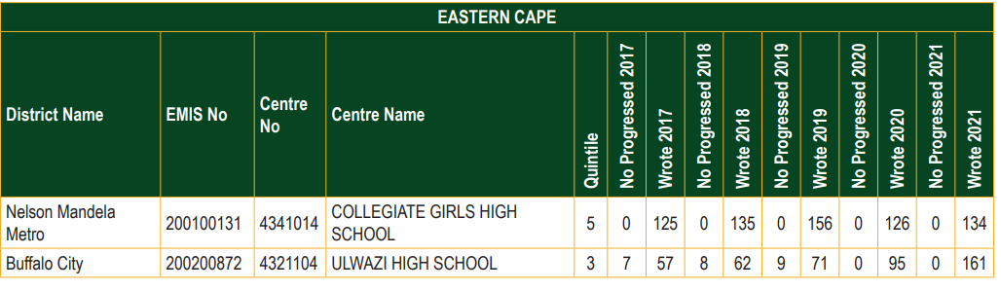
SCHOOLS THAT ACHIEVED A 100% PASS RATE FROM 2017 TO 2021

Slide 37
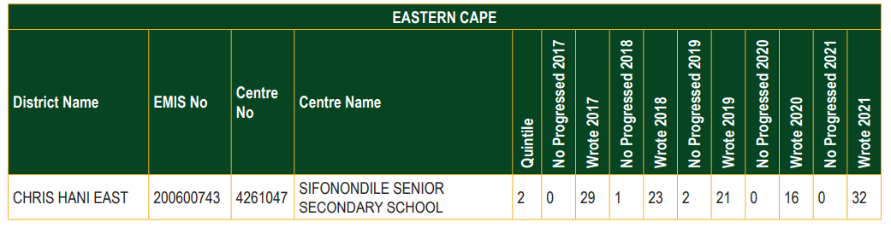
SCHOOLS THAT PERFORMED BELOW 40% OVER A FIVE -YEAR PERIOD

Slide 38




